Slide 1






Guillaume Chervet
Principal IA Engineer
AXA France
@guiChervet
Notes:
What is MLOps? This is all things that will help and support the fact of bringing artificial intelligence algorithms into production, it is not about tools or technologies; it is mainly a question of culture and good practice.
Hi, my name is Guillaume Chervet, I'm an ML engineer at AXA France. Basically, I define my role as helping data scientists to bring AI algorithms into production.
I‘m part of a team that works on real-time automatic document understanding projects. Generally, this kind of projects implements one or more Deep Learning algorithms.
Today, almost 80% of projects fail at the production stage. This does not surprise me because, this kind of projects are on the top complexities in all areas, all factors are met to make them fail.

Slide 2

Testimonial
Before SlimFaas
200 € per day
6000 € per month
SlimFaas - Guillaume Chervet - 2025

Slide 3

Testimonial
42 € per day
1260 € per month
With
So 4740 € earn each month
SlimFaas - Guillaume Chervet - 2025

Slide 4
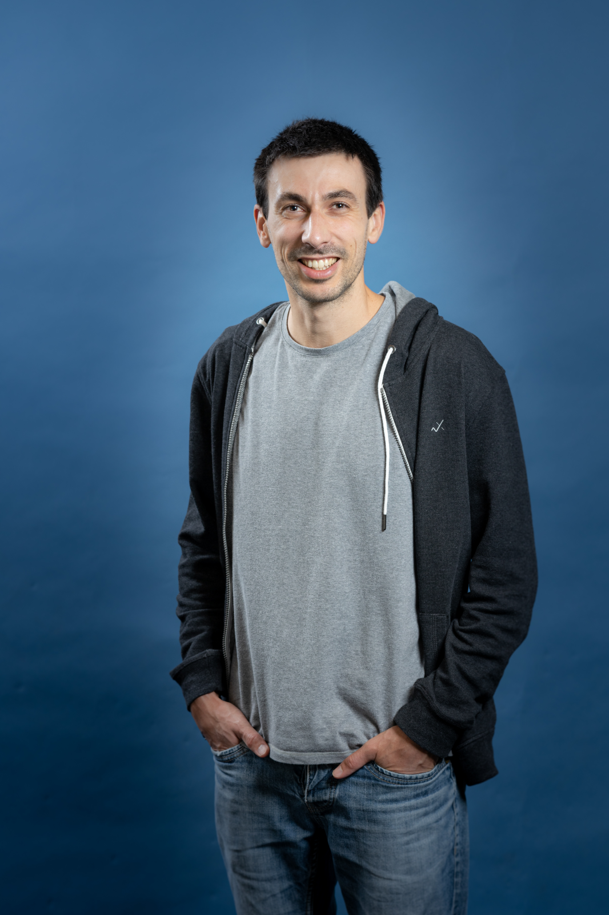
Testimonial
SlimFaas - Guillaume Chervet - 2025

Slide 5
4 environments
Testimonial
dev
staging
preprod
prod
4740 € * 4 = 18 960 € saved each month
SlimFaas - Guillaume Chervet - 2025

Slide 6
Guillaume Chervet Testimonial with
Testimonial
GREEN IT
We save 227 520 € per year on 1 project !
SlimFaas - Guillaume Chervet - 2025

Slide 7

Testimonial

Slide 8
SlimFaas
Mind Changer
Yes, but why ?
SlimFaas - Guillaume Chervet - 2025

Slide 9
SlimFaas
Mind Changer
Yes, but why ?
SlimFaas - Guillaume Chervet - 2025

Slide 10
SlimFaas
Mind Changer
Yes, but why ?
SlimFaas - Guillaume Chervet - 2025

Slide 11



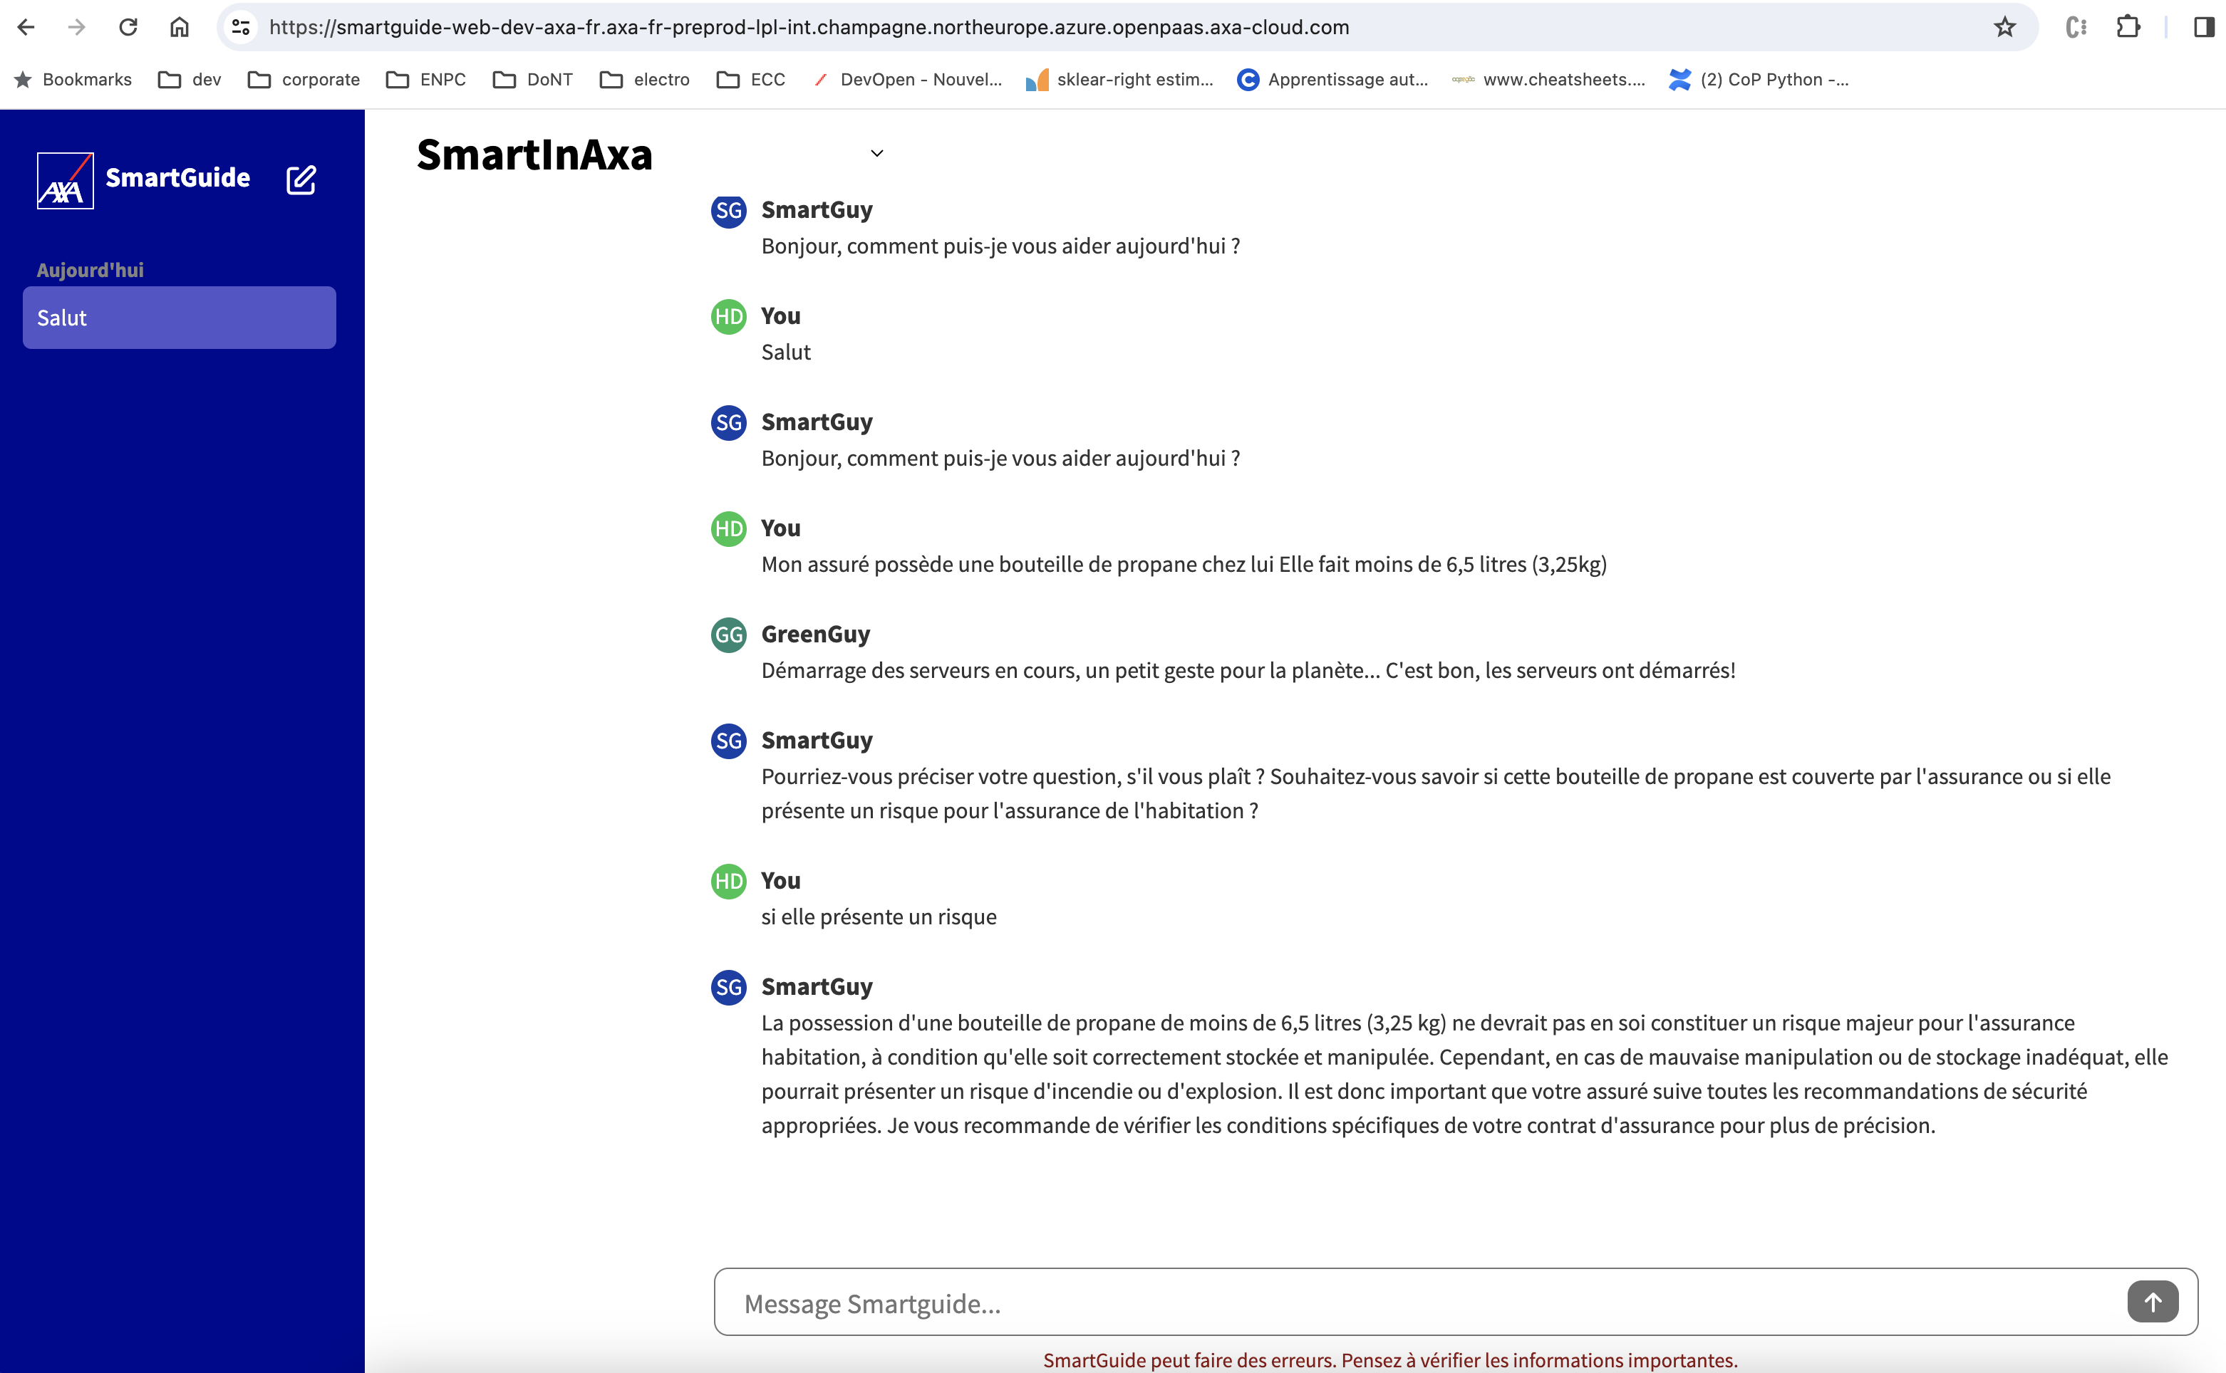
Mind Changer
nginx
nginx
HTTP call
API
API
SlimFaas - Guillaume Chervet - 2025

Slide 12
Mind Changer
nginx
nginx
HTTP call
API
SlimFaas - Guillaume Chervet - 2025

Slide 13
2 Provisionning mode
Mind Changer
Reserved
75 € / 1 Gi
Dynamic
105 € / 1Gi
SlimFaas - Guillaume Chervet - 2025

Slide 14
SlimFaas/Schedule
Mind Changer
{
"TimeZoneID":"Europe/Paris",
"Default":{
"WakeUp":["08:00"], // Wake up your infrastructure at 08:00
"ScaleDownTimeout":[
{"Time":"08:00","Value":43200}, // Scale down after 12 hours of inactivity {"Time":"19:00","Value":600} // Scale down after 10 minutes of inactivity ]
}
}
SlimFaas - Guillaume Chervet - 2024

Slide 15

Mind Changer
SlimFaas - Guillaume Chervet - 2024

Slide 16
SlimFaas
Mind Changer
Yes, but why ?
SlimFaas - Guillaume Chervet - 2025

Slide 17

WHAT NEXT ?
SlimFaas - Guillaume Chervet - 2025

Slide 18

Conclusion
https://github.com/AxaFrance/SlimFaas

Slide 19

Thank You

Slide 22




Slide 23
Why SlimFaas ?
Awesome Demo
Mind Changer
Samples
SlimFaas - Guillaume Chervet - 2024

Slide 24
Why SlimFaas ?
Awesome Demo
Mind Changer
Samples
SlimFaas - Guillaume Chervet - 2024

Slide 25
Why SlimFaas ?
Awesome Demo
Mind Changer
Samples
SlimFaas - Guillaume Chervet - 2024

Slide 26
Mind Changer: 4 Environments
dev
rec
preprod
prod
SlimFaas - Guillaume Chervet - 2024

Slide 27
Mind Changer: SlimFaas Cost
SlimFaas
3 pods * 60 Mi = 180 Mi
SlimFaas in reserved mode = 13,5 € per month.
SlimFaas - Guillaume Chervet - 2024

Slide 28
Mind Changer: SlimFaas Cost
dev
rec
preprod
prod
13,5 €
13,5 €
13,5 €
13,5 €
Total: 54 €
/ month
SlimFaas - Guillaume Chervet - 2024

Slide 29
Mind Changer: Robert Carry Application
Imagine Robert maintain an OLD Java webapp which require 1Gi of RAM and require 1 minutes to be in ready mode. Robert application is never used during the night and the week-end !
For 1 environnement:
1Gi * 2 pods = 2 Gi
In reserved mode = 75 * 2 = 150 € per month
SlimFaas - Guillaume Chervet - 2024

Slide 30
Mind Changer: Robert app Cost
dev
rec
preprod
prod
150 €
150 €
150 €
150 €
Total: 600 €
/ month
SlimFaas - Guillaume Chervet - 2024

Slide 31
Mind Changer: Robert Application with SlimFaas
Dynamic mode => 105 € for 1 Gi
1 Replica instead of always 2 => Resiliance from Javascript page
ON => 12h per days instead of 24h
For 1 environnement:
105/2 * 0.72 + 13,5 = 50,2 €
SlimFaas - Guillaume Chervet - 2024

Slide 32
Mind Changer: Robert app Cost
dev
rec
preprod
prod
50,2 €
50,2 €
50,2 €
50,2 €
Total: 200,8 €
/ month
SlimFaas - Guillaume Chervet - 2024

Slide 33

Before SlimFaas
600 € / month
SlimFaas - Guillaume Chervet - 2024

Slide 34

After SlimFaas
200,8 € / month
We divide costs by 3
SlimFaas - Guillaume Chervet - 2024

Slide 35
Robert Carry Testimonial with SlimFaas
We save 400 * 12 = 4800€ per year
GREEN IT
SlimFaas - Guillaume Chervet - 2024

Slide 36
Why SlimFaas ?
Awesome Demo
Mind Changer
Samples
SlimFaas - Guillaume Chervet - 2024

Slide 37
Everything as API
Sample: GenIA/LLM Plateform
Customers Data API v1
Vehicules data API v1
HTTP POST
https://smartguide-rec.axa-fr.intraxa/function/smartguide-v1/stream
{…}
SmartGuide API v1
Proxy-LLM API v1
SmartOther-data API v1

Slide 38
Sample: GenIA/LLM Plateform
OpenShift
LLM Proxy API
User Network
Front Web
Browser
Web
Users
SlimFaas
SmargGuide API v1
Async
API Datav1
SlimFaas
Database SQL
SlimFaas - Guillaume Chervet - 2024

Slide 39
Sample: GenIA/LLM Plateform
Versionning
HTTP POST
https://smartguide-rec.axa-fr.intraxa/function/smartguide-v1/stream
{…}
Function
Smartguide-v1
SlimFaas
HTTP POST
https://smartguide-rec.axa-fr.intraxa/function/smartguide-v2/stream
{…}
Function
Smartguide-v2

